Slide 1
Facial Recognition Using Convolutional Neural Networks
Nathik Salam
Devan Carlson

Slide 2
Project Goals
Learn about different computer learning techniques and which works best for computer vision problems
Develop a computer system to be able to recognize a finite number of faces with high accuracy

Slide 3
Goal of Neural Networks
Use what we know about how the brain works to develop an algorithm that makes it so computers can learn in a similar way to humans..
We receive sensory data -- and our brain recognizes patterns (color, shape, etc) and we make a decision what we’re looking at.
Finite number of inputs → Finite number of outputs

Slide 4
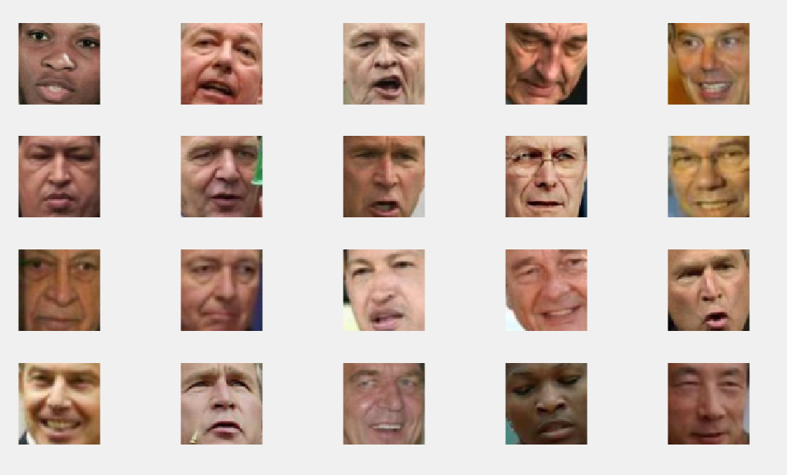
Overview of Convolutional Neural Networks
Input: 64x64x3 Face image
Output: 1 of 12 people

Slide 5
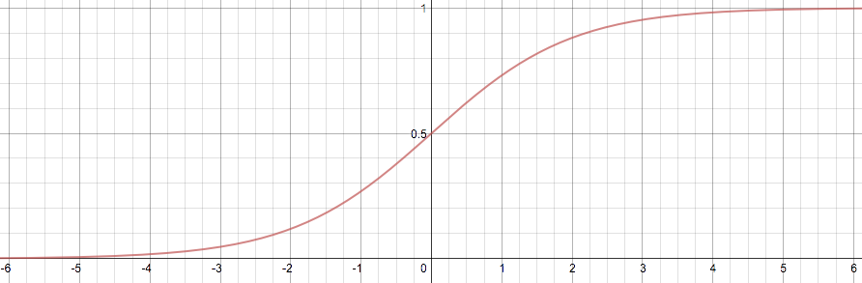

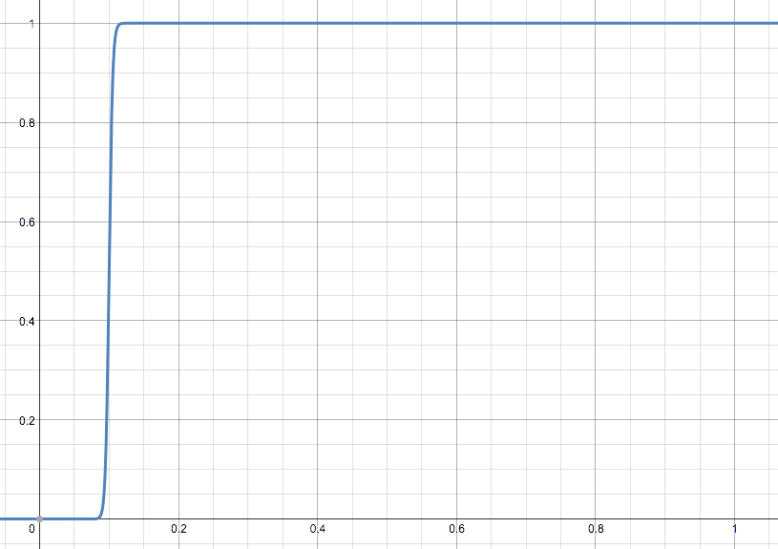
x
1
Input
Neuron
{
σ(wx+b)
output(x)=
1 if x > 0.1
0 if x < 0.1
x
output
0.1
σ(wx+b)→
0
Pseudocode
if(x>0 .1)
output=1
if(x<0.1)
output=0

Slide 6
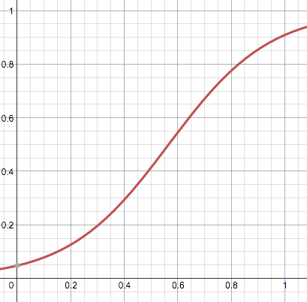
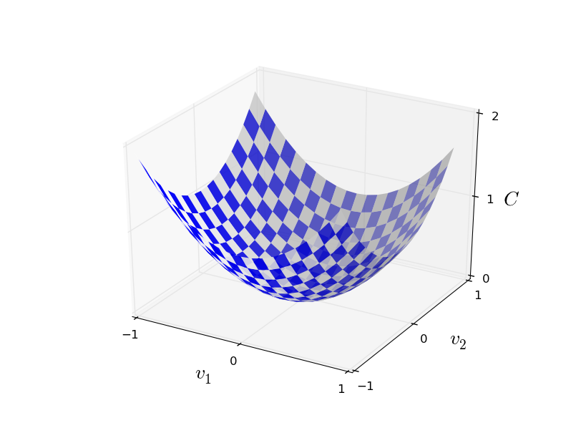
w→weight
b→bias
Training Data
Network Computations
x > 0.1
σ(wx+b)
n | x | output
1 | 0.05 | 0
2 | 0.45 | 1
3 | 0.00 | 0
. | . | .
. | . | .
1000 | 0.6 | 1
output | cost | Δw | Δb
0.4 | 0.36 | -0.5 | -0.3
0.2 | 0.04 | 0.7 | 0.4
0.6 | 0.16 | -0.4 | -0.2
. | . | . | .
. | . | . | .
0.9 | 0.1 | 0.1 | 0.0
x
output
σ(wx+b)→
2
C = (output-output)
2
C(w,x) = (output-σ(wx+b))
C
Δw = ∂C/∂w
Δb = ∂C/∂b
b
w

Slide 7
y
1
0.6
a=σ(w₁x+w₂y+b)
x
σ(w₁a+w₂a+b)
x
output
0
0.1
1
a=σ(w₁x+w₂y+b)
y
{
output(x,y) =
X > 0.1 and y < 0.6
0 otherwise

Slide 8
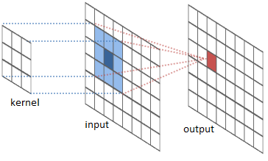
What is Convolution?

Slide 9
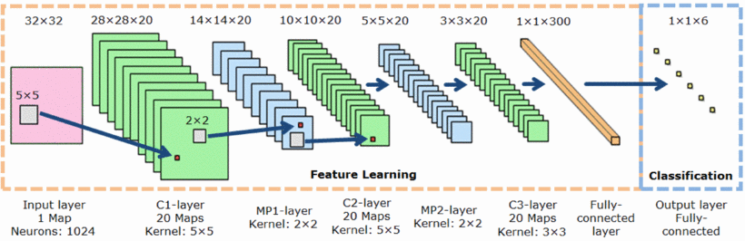
Convolutional Neural Networks

Slide 10
Steps to implement Convolutional NN
Determine a series of filter dimensions that filter your image data from input image dimensions to 1 answer
Input: 64x64x3 Face image
Output: 1 of 12 people
Initialize the filters to random values
Training phase
Calculus to calculate the error, and backpropagate through the network to modify the filter weights to get closer to the right answer
Validation phase
See how well the training has done so far, and stop training if meets a threshold (90% accuracy)

Slide 11
Our Face Database
LFW (Live Faces in the Wild) -- cropped to 64x64 of just the face
13,000 images of faces collected from the web
We used a subset of these to only people that had 50 or more images
12 people
50 images each
45 images for training
5 images for testing

Slide 12
Filter Sizes Example
Input: 64x64x3
64x64x3 Image→ 5x5x3 Convolution Filter → 60x60 image
60x60 Image → 2x2 step size 2 Max Pooling Filter → 30x30 image
30x30 Image → 5x5 Convolution Filter → 26x26 image
26x26 Image → 2x2 step size 2 Max Pooling Filter → 13x13 Image
13x13 Image → 13x13 Convolution Filter → 1 answer

Slide 13
Our Approach
Get something working
Experiment with the values of:
Filter sizes in each layer
Number of filters in each layer
Number of epochs
Batchsize
Learning Rate

Slide 14
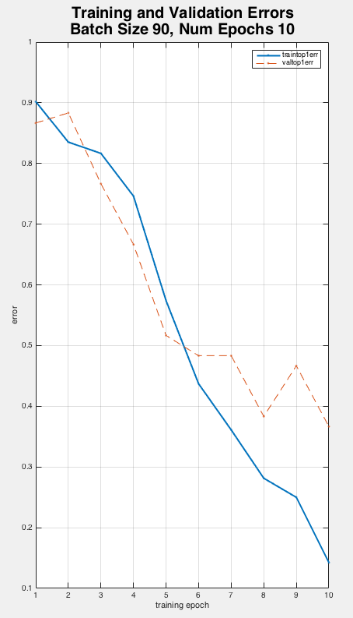
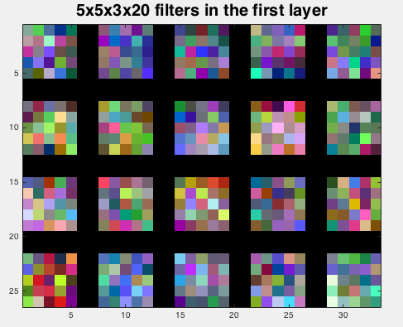
Results

Slide 15
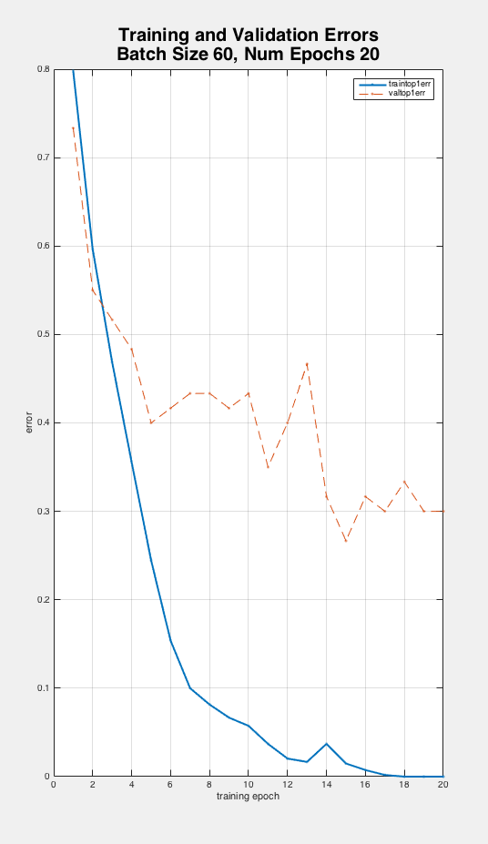
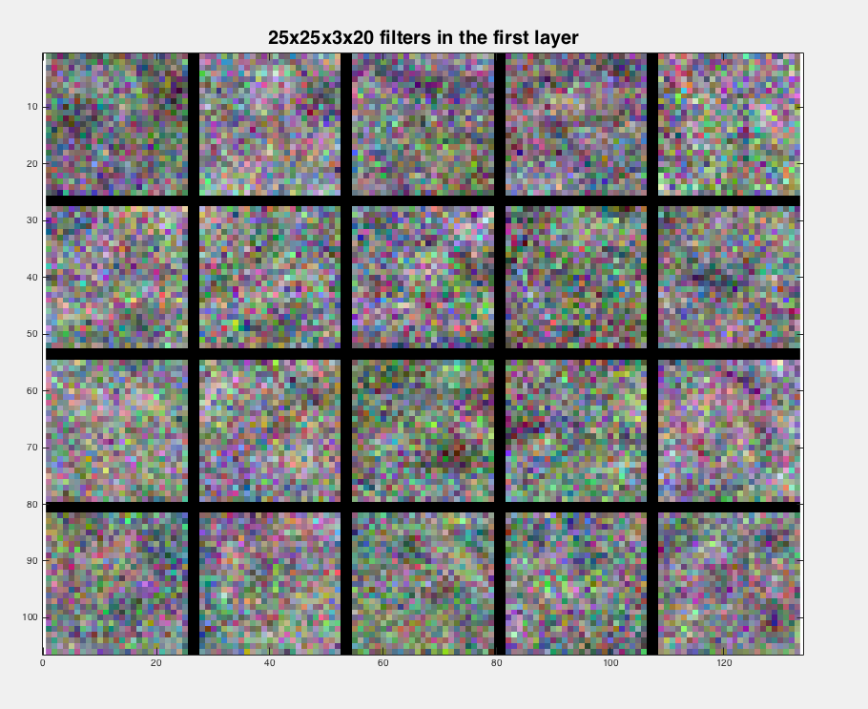

Slide 16
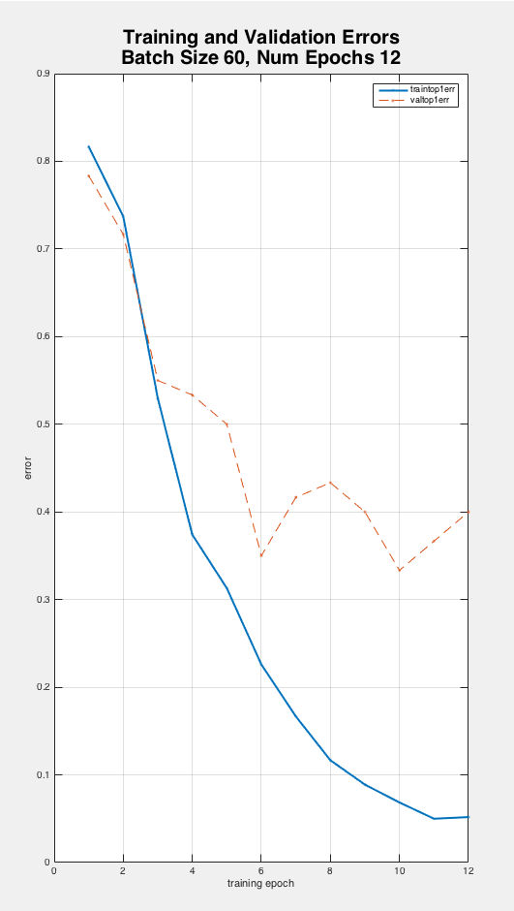
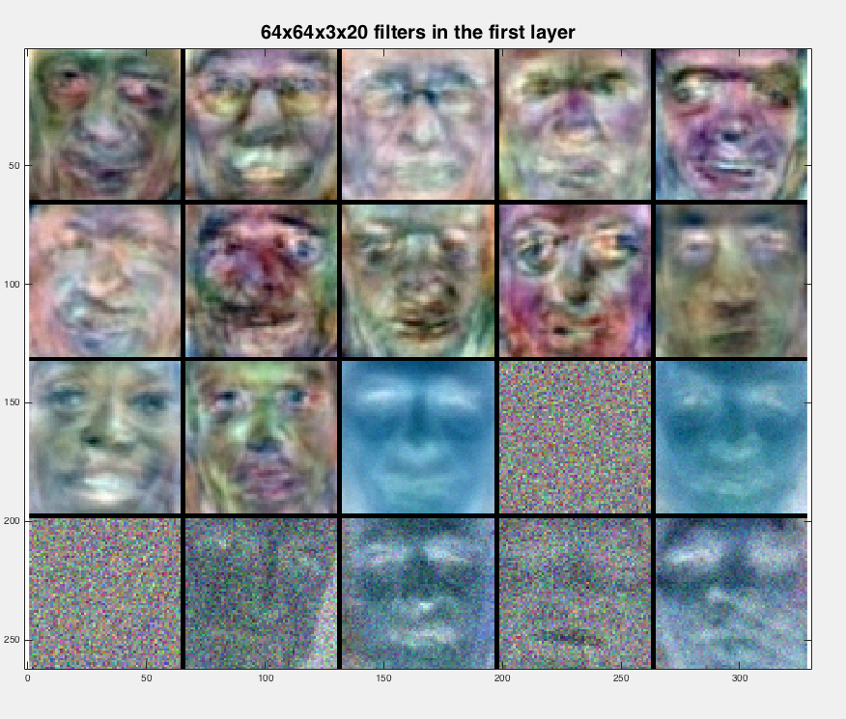

Slide 17
Limitations
Time
Imperfect face images
Different facial expressions, viewing angles, lighting, etc.
Small training set
mnist

Slide 18
Next Steps
Determine best filter sizes and number of layers for detecting patterns on people’s faces.
Find a better database of face images
Improve the algorithm to detect faces in an image, resize, then compare to database

Slide 19
Bibliography
Face Database came from: http://vis-www.cs.umass.edu/lfw/
Matlab Convolutional NN Library http://www.vlfeat.org/matconvnet/
Tutorial on MatConvNet http://www.robots.ox.ac.uk/~vgg/practicals/cnn/index.html

